Slide 1
https://www.mongodb.com/what-is-mongodb
MongoDB stores data in flexible, JSON-like documents, meaning fields can vary from document to document and data structure can be changed over time
The document model maps to the objects in your application code, making data easy to work with
Ad hoc queries, indexing, and real time aggregation provide powerful ways to access and analyze your data
MongoDB is a distributed database at its core, so high availability, horizontal scaling, and geographic distribution are built in and easy to use
MongoDB is free and open-source, published under the GNU Affero General Public License

Slide 2
document-oriented database
A document-oriented database is a db program designed for storing, retrieving, and managing document-oriented information, also known as semi-structured data.
Document-oriented databases are one of the main categories of NoSQL databases and the popularity of the term "document-oriented database" has grown with the use of the term NoSQL itself.
Document-oriented databases are a subclass of the key-value store, another NoSQL database concept. The difference lies in the way the data is processed; in a key-value store the data is considered to be inherently opaque to the database, whereas a document-oriented system relies on internal structure in the document in order to extract metadata that the database engine uses for further optimization.
Document databases contrast strongly with the traditional relational database .
Relational databases generally store data in separate tables that are defined by the programmer, and a single object may be spread across several tables.
Document databases store all information for a given object in a single instance in the database, and every stored object can be different from every other.
This makes mapping objects into the database a simple task, normally eliminating anything similar to an object-relational mapping.

Slide 3
How to use free MongoDB in the cloud
There are several companies offering MongoDB “as a service” in the cloud. Most of them will let you have a small (500 MB) database for free, and then they charge money if you want a larger one.
We are going to use www.mlab.com
Mostly because I started with that one and it is easy and gives my no problems.

Slide 4
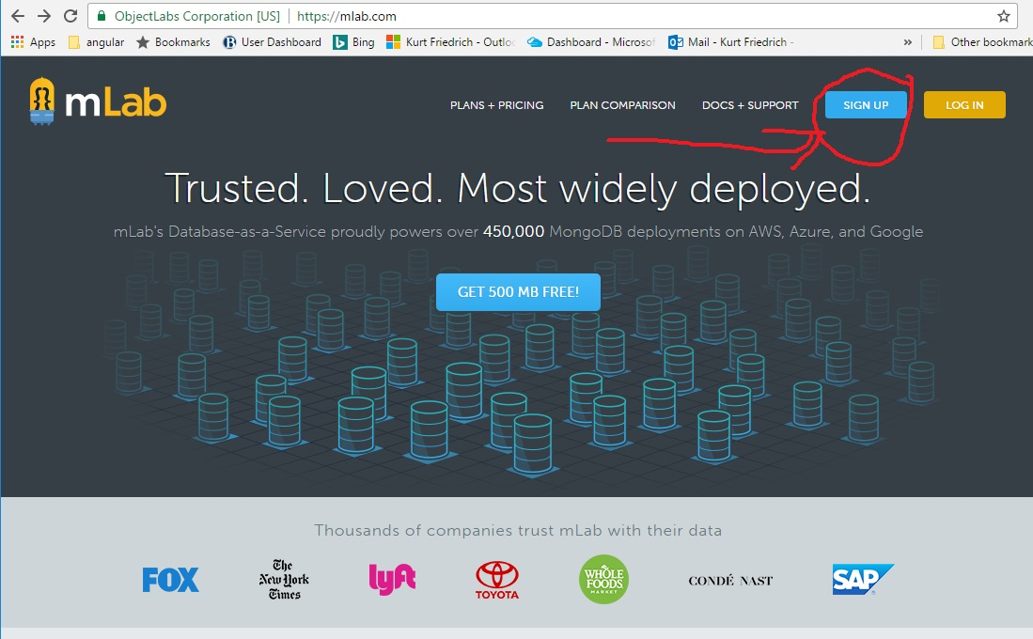
Go to mlab.com and create a new account

Slide 5
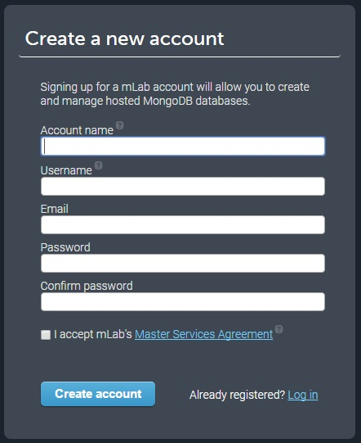
This account is the “Manager” Account. It is not the account name you access data with.

Slide 6
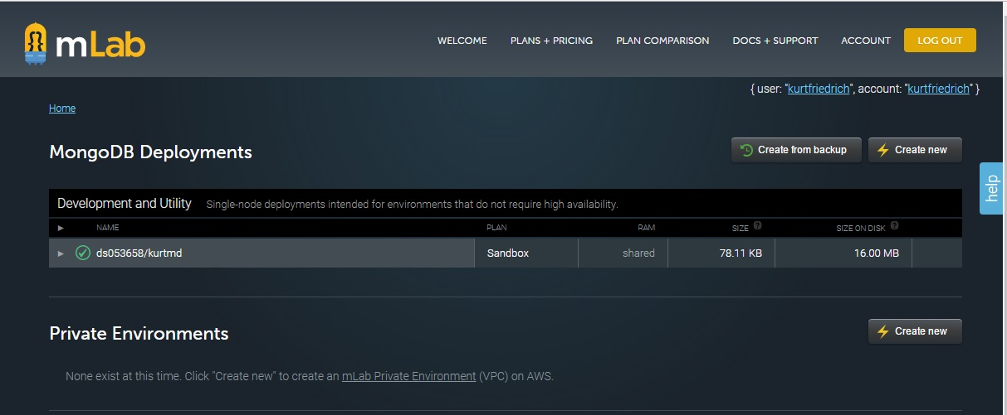
Create a new Database (I already had one, kurtmd as in kurt’s Mongo Database)
After you create a new database, click on that DB ( in my case, ds053658/kurtmd )

Slide 7
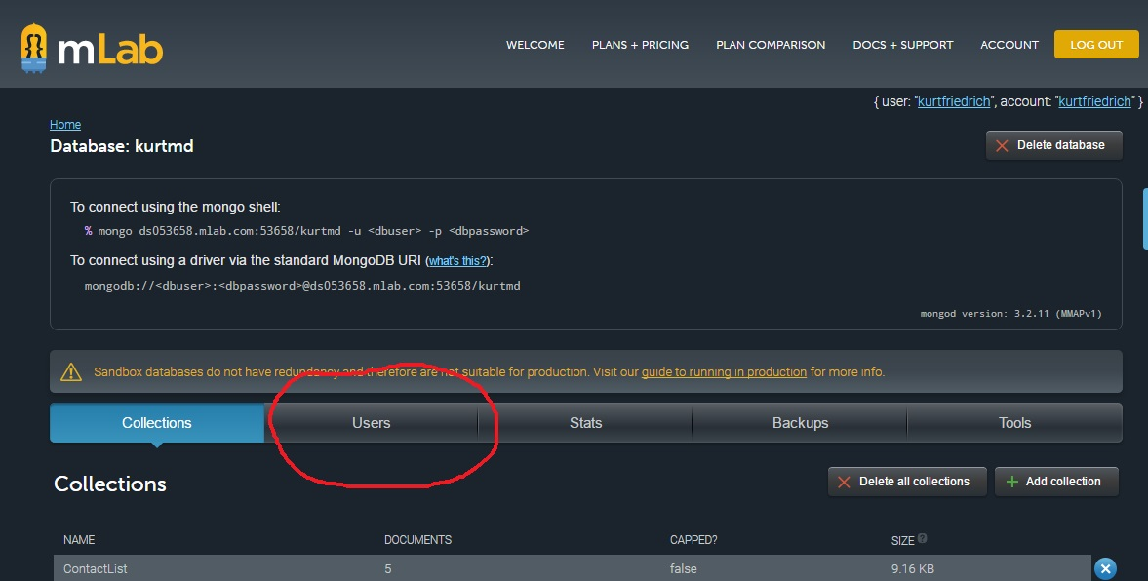
First add a DataBase user this is an account name and pw you will use to access mongo form your code.

Slide 8
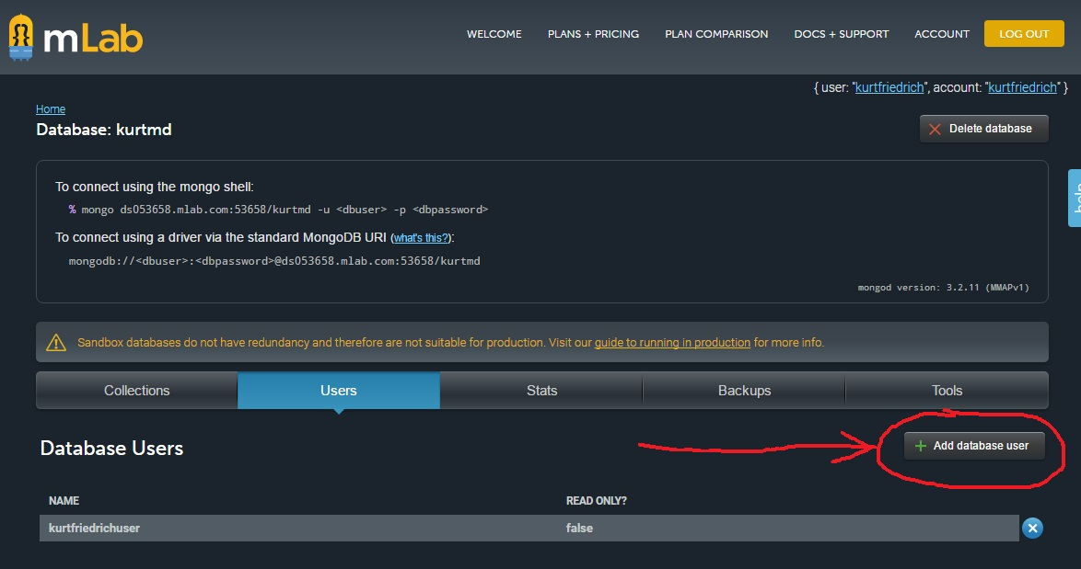
Remember your Management account name and PW. This user account/pw can always be looked up, or deleted and recreated.
Now click on your database name (upper left) to go back there.

Slide 9
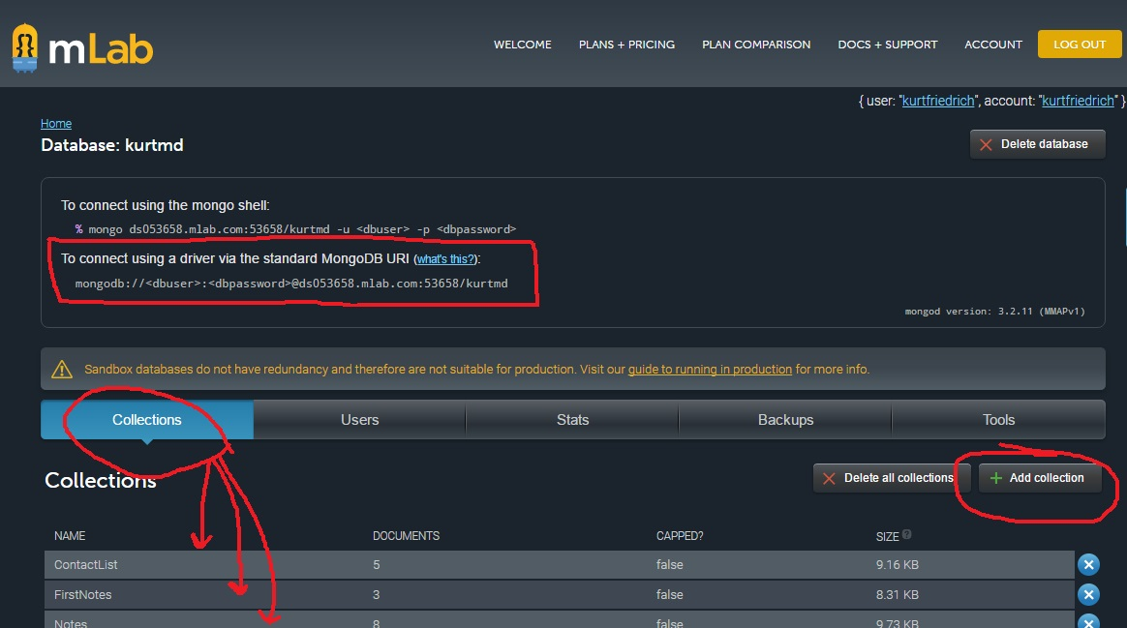
You can create new collections, as well as examine ones you already have. Also your JS code can create a new one just be referencing a new collection name.

Slide 10
Copy down this connection string which you will use in JS code to read and write the database. You will substitute the 2nd username/pw you created, your user account, not your management account, in this string.

